Slide 1


Slide 2
Compiler Construction
Teacher : Zulfiqar Ali
Email: Zulfiqar.rafique@nu.edu.pk
Office: No.6,Basement -1 (CS Block 1)

Slide 3
Week 12-13
Intermediate Code Generation
DAG(Directed Acyclic Graph)
3 Address Code
Syntax Tree

Slide 4
Intermediate Code Generation
In the analysis-synthesis model of a compiler, the front end of a compiler translates a source program into an independent intermediate code.
Back end of the compiler uses this intermediate code to generate the target code

Slide 5
What Intermediate Code
If a compiler translates the source language to its target machine language without having the option for generating intermediate code, then for each new machine, a full native compiler is required
Intermediate code eliminates the need of a new full compiler for every unique machine by keeping the analysis portion same for all the compilers
The second part of compiler, synthesis, is changed according to the target machine
It becomes easier to apply the source code modifications to improve code performance by applying code optimization techniques on the intermediate code

Slide 6
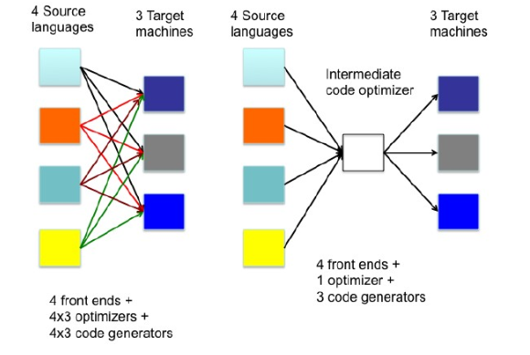
What Intermediate Code

Slide 7
Intermediate Representation
Intermediate codes can be represented in a variety of ways and they have their own benefits
High Level IR - High-level intermediate code representation is very close to the source language itself. They can be easily generated from the source code and we can easily apply code modifications to enhance performance. But for target machine optimization, it is less preferred
Low Level IR -This one is close to the target machine, which makes it suitable for register and memory allocation, instruction set selection, etc. It is good for machine-dependent optimizations
Intermediate code can be either language specific (e.g., Byte Code for Java) or language independent (three-address code).

Slide 8
High Level IR
HIR is typically an Abstract Syntax Tree (AST) which maintains the program's structure and high-level constructs.

Slide 9
Low Level IR
LIR often uses Three-Address Code (TAC) or Register Transfer Language, which break down operations into simpler, machine-like instructions and use explicit jumps for control flow.

Slide 10
Intermediate Languages Types
Graphical IRs: Abstract Syntax trees, DAGs, Control Flow Graphs
Linear IRs:
Stack based (postfix)
Three address code (quadruples)

Slide 11
Graphical IRs
Abstract Syntax Trees (AST) – retain essential structure of the parse tree, eliminating unneeded nodes.
Directed Acyclic Graphs (DAG) – compacted AST to avoid duplication – smaller footprint as well
Control flow graphs (CFG) – explicitly model control flow

Slide 12
ASTs and DAGs: a := b *-c + b*-c
:=
:=
a
+
a
+
*
*
*
b
- (uni)
b
- (uni)
b
- (uni)
c
c
c

Slide 13
Linearized IC
Stack based (one address) – compact
push 2
push y
multiply
push x
subtract
Three address (quadruples) – up to three operands, one operator
t1 <- 2
t2 <- y
t3 <- t1 * t2
t4 <- x
t5 <- t4 – t1

Slide 14
Directed Acyclic Graphs for Expressions
Like syntax trees, but with shared common subexpressions
Leaves = atomic operands
Interior nodes = operators
Key difference: Nodes can have multiple parents

Slide 15
Why DAGs?
More succinct representation than syntax trees
Provides compiler with optimization clues
Enables efficient code generation

Slide 16
DAG vs Syntax Tree
Syntax Tree Approach
Replicates common subexpressions
Each occurrence gets its own subtree
Inefficient representation
DAG Approach
Shares common subexpressions
Single node represents multiple occurrences
Compact representation

Slide 17
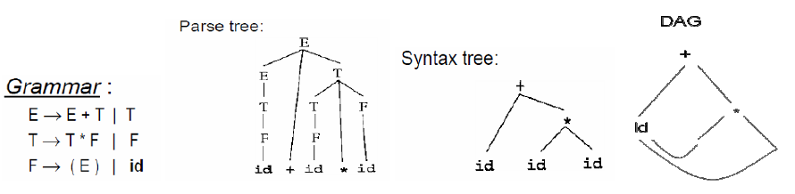
Visual Difference

Slide 18
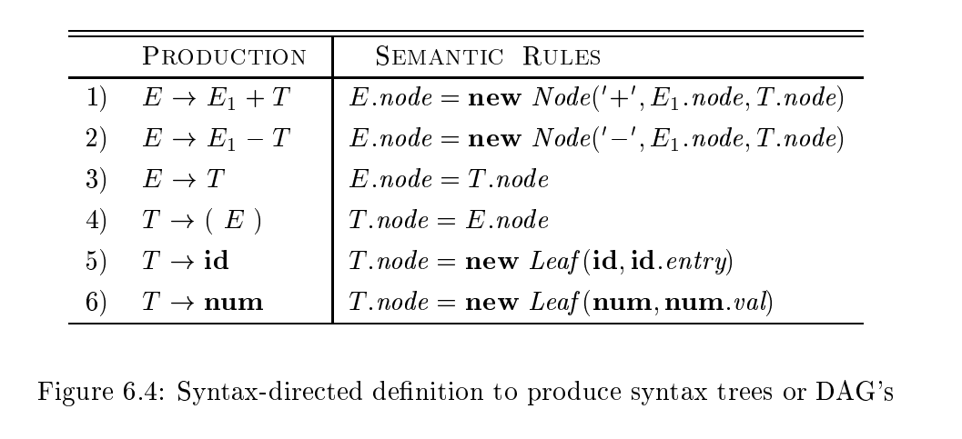
SDD to produce Syntax Tree or DAG

Slide 19
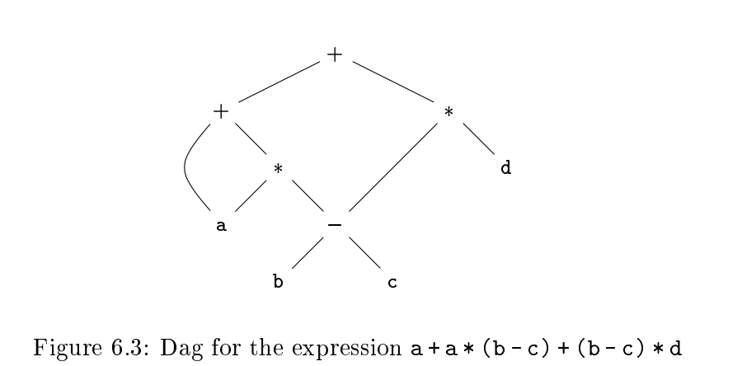
DAG Example

Slide 20
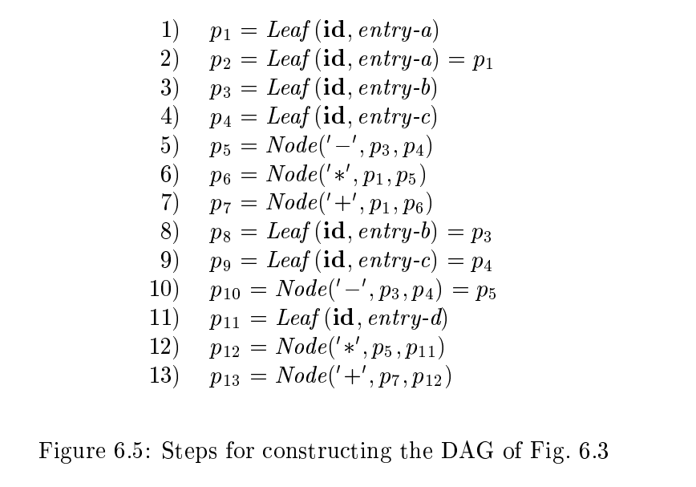
Steps for construction DAG

Slide 21
Constructing Rules for DAG’s
Interior nodes always represent the operators.
Exterior nodes (leaf nodes) always represent the names, identifiers or constants.
A check is made to find if there exists any node with the same value.
A new node is created only when there does not exist any node with the same value.
This action helps in detecting the common sub-expressions and avoiding the re-computation of the same.
The assignment instructions of the form x:=y are not performed unless they are necessary.

Slide 22
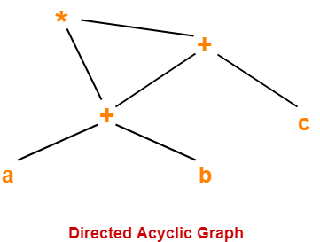

Slide 23
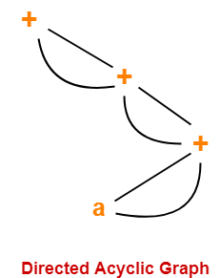

Slide 24
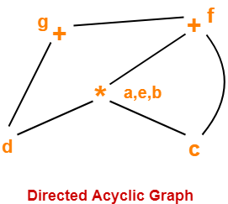
Consider the following block and construct a DAG for it-
(1) a = b x c
(2) d = b
(3) e = d x c
(4) b = e
(5) f = b + c
(6) g = f + d

Slide 25
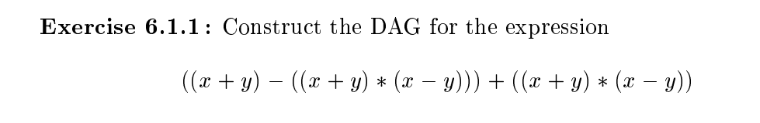

Slide 26
Value Number Method for Constructing DAG’s
Efficient technique for constructing DAGs
Assigns unique "value numbers" to distinct expressions
Enables quick identification of common subexpressions
Widely used in compiler optimization

Slide 27
Applications of DAG in Compiler
Code optimization: DAGs identify and eliminate redundant computations, also known as common sub-expressions, to make code more efficient.
Code generation: They assist in generating efficient machine code by representing intermediate code and helping with tasks like register allocation

Slide 28
Three-Address Code
Instructions are very simple : LHS is the target and the RHS has at most two sources and one operator.
RHS sources can be either variables or constants.
Examples: a = b + c, x = -y, if a > b Goto L1
Three-address code is a generic form and can be implemented as quadruples, triples, indirect triples.
Example: The three-address code for (a+b*c)- (d/(b*c)) is below.

Slide 29
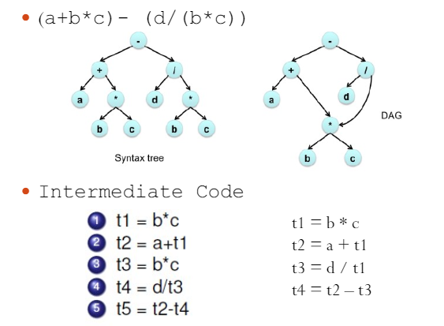
IR Code is Made From

Slide 30
General Form-3 Address Code
In general, Three Address instructions are repressented as- a = b op c
Here, a, b and c are the operands.
Operands may be constants, names, or compiler generated temporaries.
op represents the operator.

Slide 31
Examples
Write Three Address Code for the following expression- a = b + c + d
Three Address Code for the given expression is-
T1 = b + c
T2 = T1 + d
a = T2

Slide 32
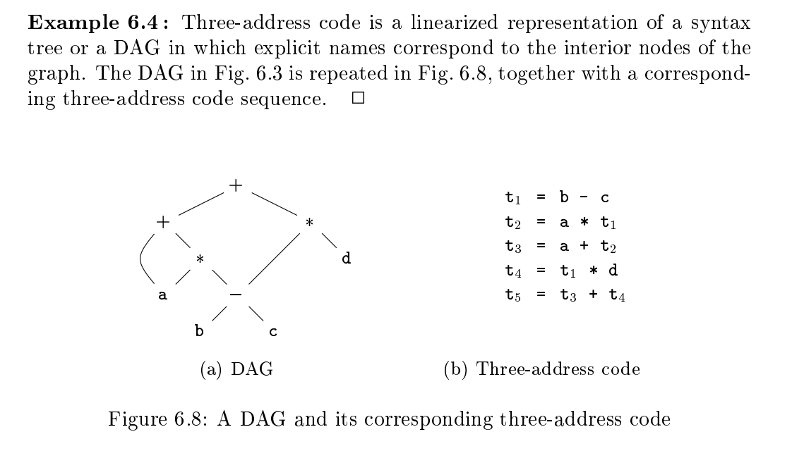

Slide 33
Common Three Address Instruction Forms
The common forms of Three Address instructions are
Assignment Statement (x = y op z and x = op y)
Copy Statement (x = y)
Conditional Jump (If x relop y Goto X)
Unconditional Jump (Goto X)
Procedure Call- (param x call p return y)

Slide 34
3 Address Code Examples
Generate three address code for the following code-
c = 0
do
{
if (a < b) then
x++;
else
x–;
c++;
} while (c < 5)
Three address code for the given code is-
c = 0
if (a < b) goto (4)
goto (7)
T1 = x + 1
x = T1
goto (9)
T2 = x – 1
x = T2
T3 = c + 1
c = T3
if (c < 5) goto (2)

Slide 35
Generate three address code for the following code-
while (A < C and B > D) do
if A = 1 then C = C + 1
else
while A <= D
do A = A + B
Three address code for the given code is-
if (A < C) goto (3)
goto (15)
if (B > D) goto (5)
goto (15)
if (A = 1) goto (7)
goto (10)
T1 = c + 1
c = T1
goto (1)
if (A <= D) goto (12)
goto (1)
T2 = A + B
A = T2
goto (10)

Slide 36
Generate three address code for the following code-
switch (ch)
{
case 1 : c = a + b;
break;
case 2 : c = a – b;
break;
}
Three address code for the given code is-
if ch = 1 goto L1
if ch = 2 goto L2
L1:
T1 = a + b
c = T1
goto Last
L2:
T1 = a – b
c = T2
goto Last
Last:

Slide 37
Ways to Represent Three –Address Code
There are 3 ways to represent a Three-Address Code in compiler design:
Quadruples
Triples
Indirect Triples

Slide 38
Quadruples
A quadruple is a record structure with four fields, which are, op, arg1, arg2 and result.
The op field contains an internal code for the operator. The three-address statement x : = y op z is represented by placing y in arg1, z in arg2 and x in result.
The contents of fields arg1, arg2 and result are normally pointers to the symbol-table entries for the names represented by these fields. If so, temporary names must be entered into the symbol table as they are created.

Slide 39
Example
a := -b * c + d
Three Address Code
t1 := -b t2 := c + d t3 := t1 * t2 a := t3
Quaderples
 | Operator | Source 1 | Source 2 | Destination
(0) | uminus | b | - | t₁
(1) | + | c | d | t₂
(2) | * | t₁ | t₂ | t₃
(3) | := | t₃ | - | a

Slide 40
Triples
The triples have three fields to implement the three address code. The field of triples contains the name of the operator, the first source operand and the second source operand.
In triples, the results of respective sub-expressions are denoted by the position of expression. Triple is equivalent to DAG while representing expressions.

Slide 41
Example
a := -b * c + d
Three address code is as follows:
t₁ := -b t₂ := c + d t₃ := t₁ * t₂ a := t₃
 | Operator | Source 1 | Source 2
(0) | uminus | b | -
(1) | + | c | d
(2) | * | (0) | (1)
(3) | := | (2) | -

Slide 42
Indirect Triples
This representation makes use of pointer to the listing of all references to computations which is made separately and stored. Its similar in utility as compared to quadruple representation but requires less space than it. Temporaries are implicit and easier to rearrange code.

Slide 43
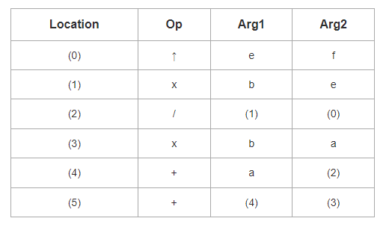
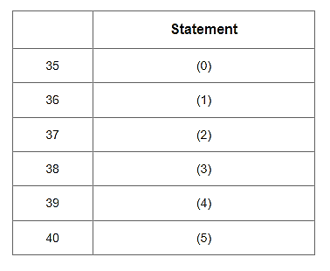
a + b x c / e ↑ f + b x c

Slide 44
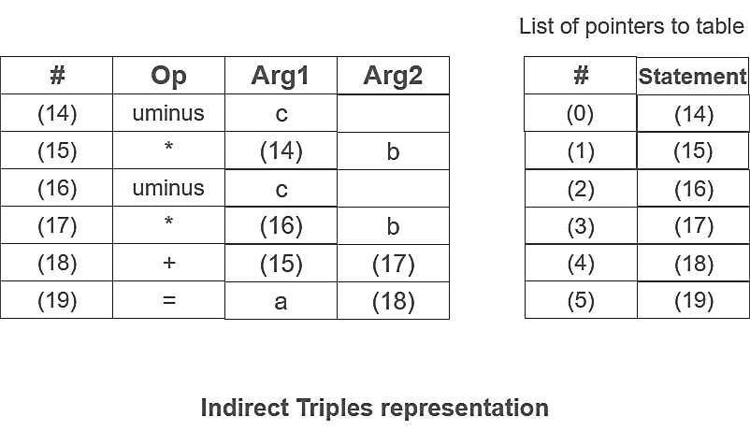
Example:
Consider expression a = b * – c + b * – c

Slide 45
Reference
Compilers: Principles, Techniques, and Tools, A. V. Aho, R. Sethi and J. D. Ullman, Addison-Wesley, 2nd ed., 2006.

Slide 46
THANK YOU

